Slide 1
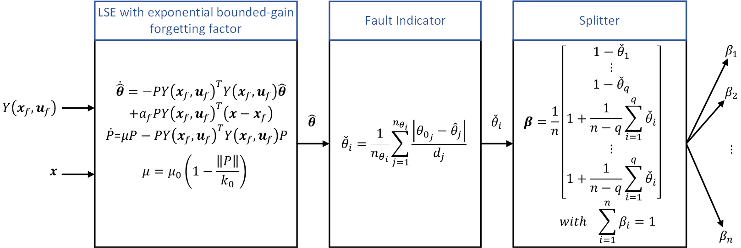
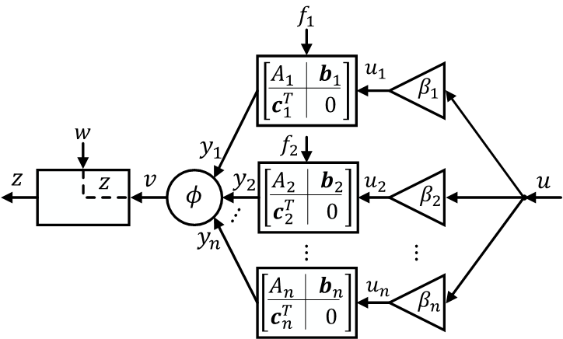
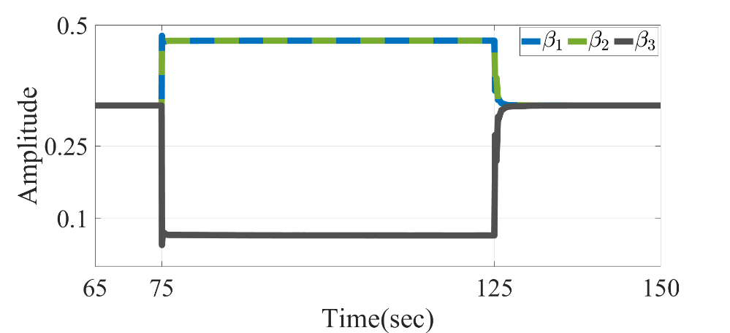
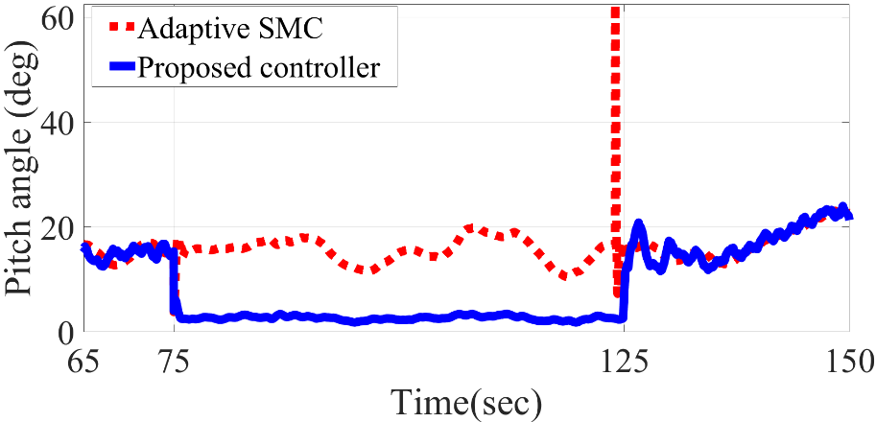
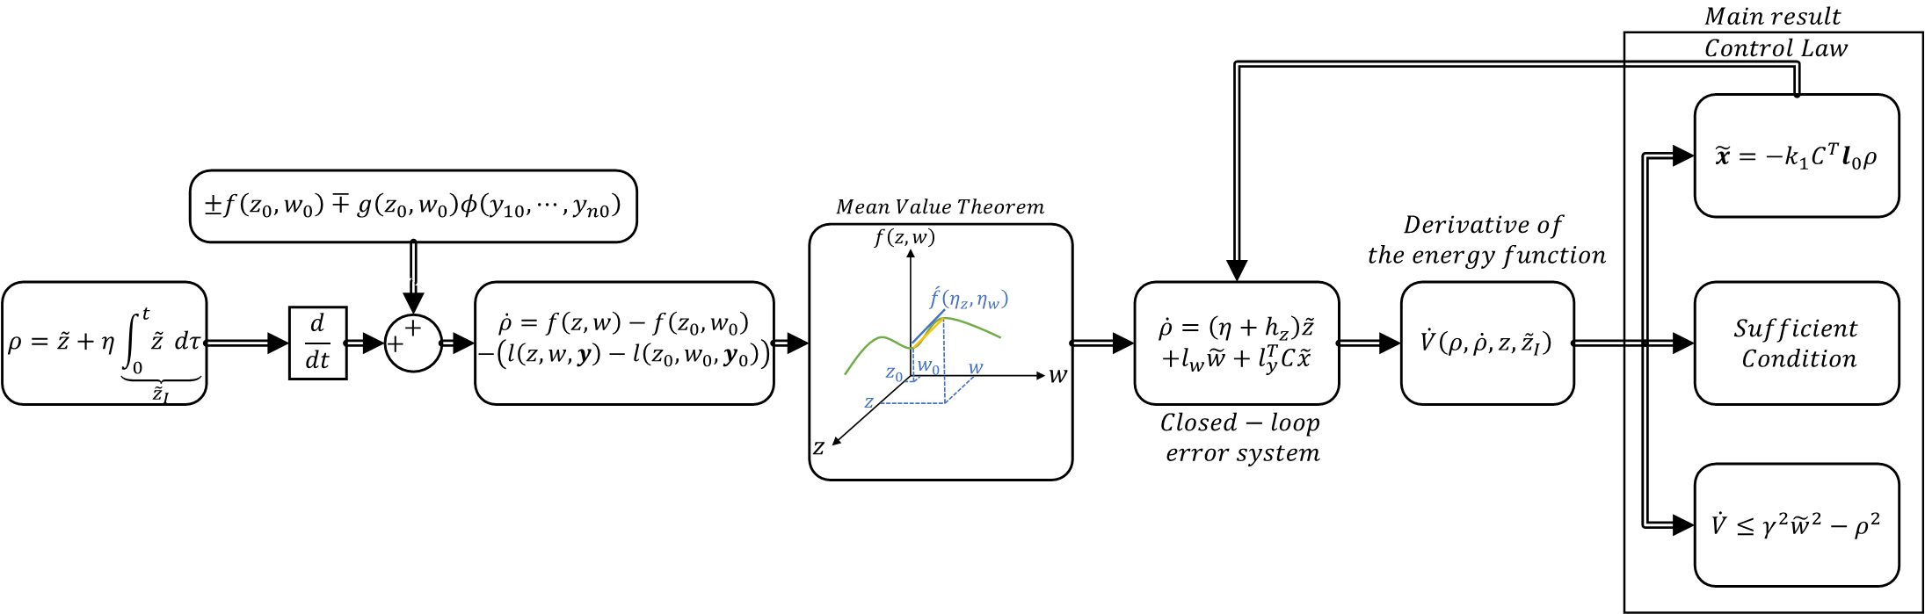
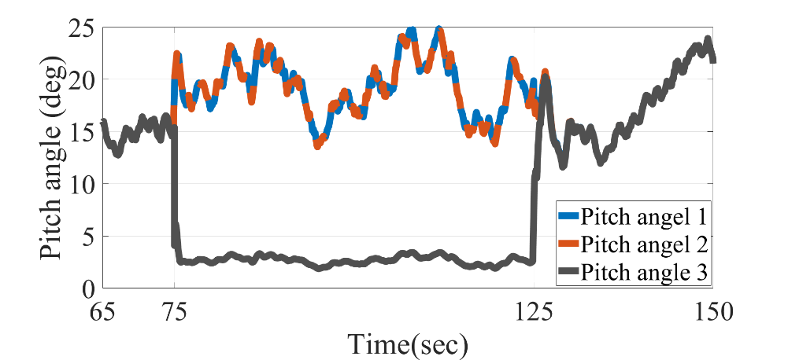
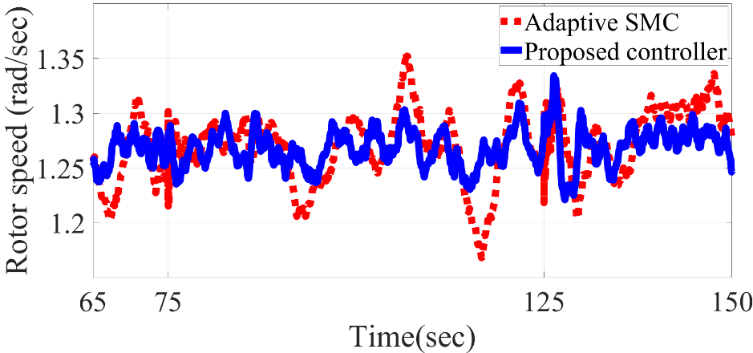
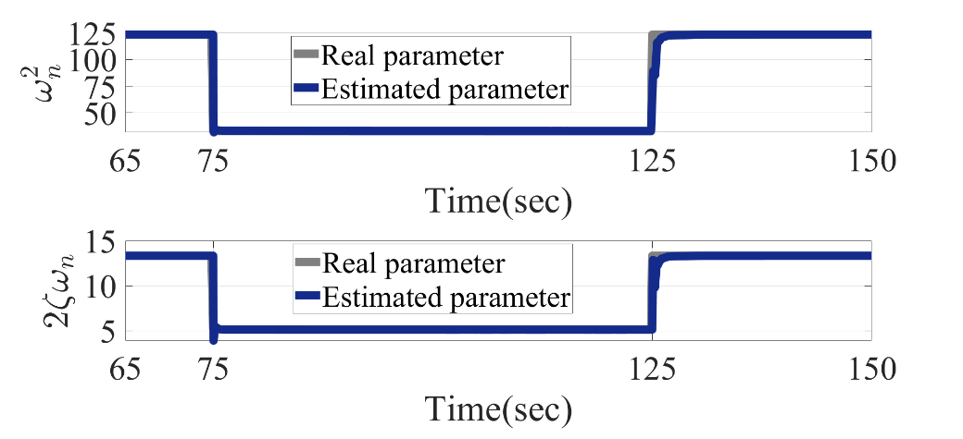
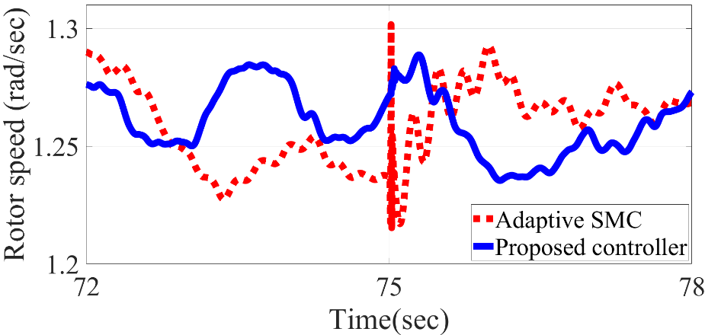
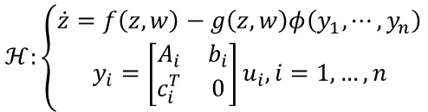

Distributed Robust Adaptive Control for Coupled Nonlinear Systems with Actuator Faults
System model
Control Development
$$ℋ:\left\{\begin{aligned}\dot{z}=f\left(z,w\right)−g\left(z,w\right)φ\left(y_{1},⋯,y_{n}\right) \\ y_{i}=\left[\begin{matrix}A_{i} & b_{i} \\ c_{i}^{T} & 0\end{matrix}\right]u_{i}, i=1,…,n\end{aligned}\right.$$
Control allocation schematic
Results generated by FAST Simulator Developed by NREL
High-level Control
Low-level Control
$u=−φ\left(x_{0}\right)−βk_{2}^{T}e$.

Slide 2
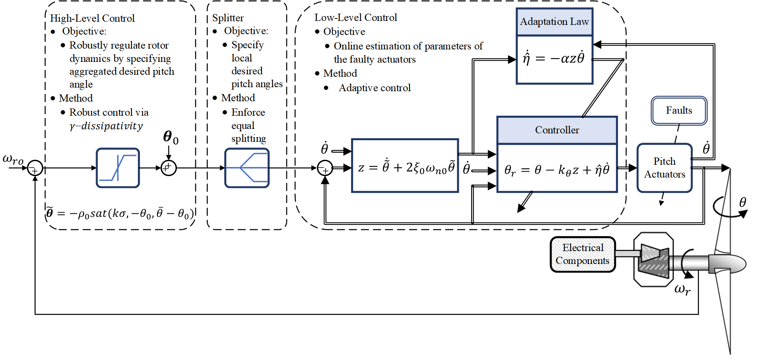
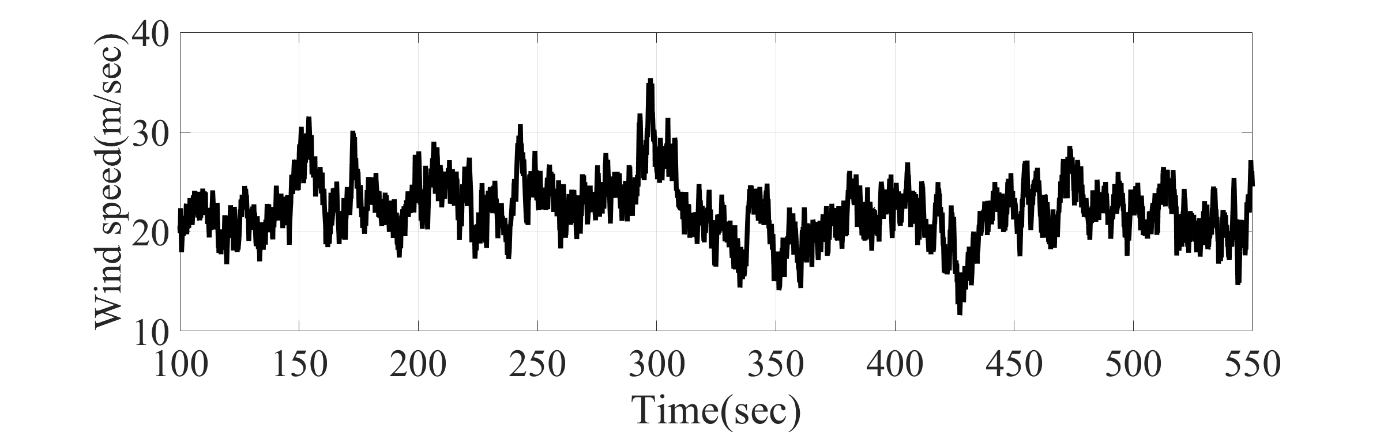
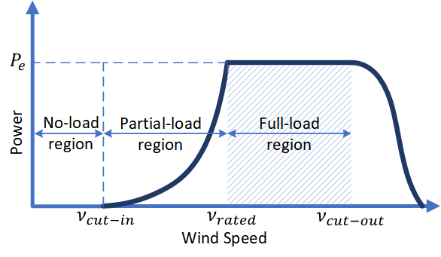
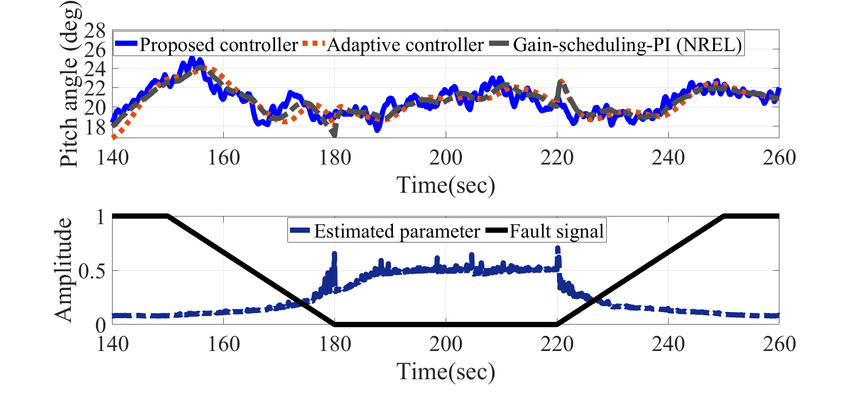
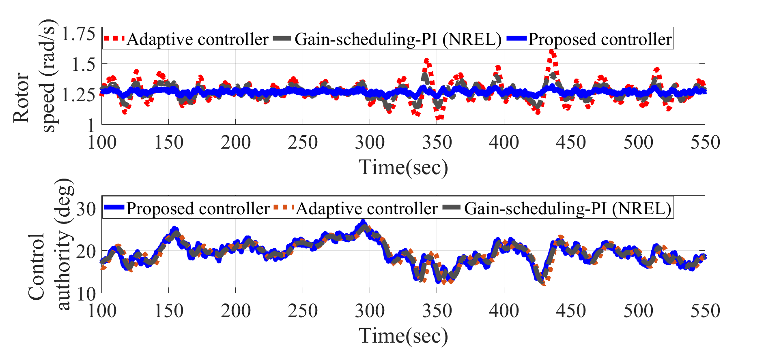




















Hierarchical Robust Adaptive Control for Wind Turbines with Actuator Fault
$$ℒ_{2} Metric Space$$
$$Positively invariant set$$
$${\left\|f\right\|}_{2}≜{\left(\int_{0}^{∞}{{\left\|f\left(τ\right)\right\|}^{2}}dτ\right)}^{1/2}<∞$$
$dist$($\tilde{ω}\left(t\right)−𝔹_{r}(0)$)$<ε,∀ t>T$
$$𝔹_{r}\left(0\right)=\left\{\tilde{ω}\left(t\right):\left|\tilde{ω}\left(t\right)\right|<r\right\}$$
$$v$$
$$G$$
${r=\overline{σ}}_{v}γ$,
$$\left|\tilde{v}\right|≤{\overline{σ}}_{v}$$
$$u$$
$$ω$$
$$𝔹_{r}\left(0\right)$$
$$\tilde{ω}\left(t\right)$$
$$\tilde{ω}\left(t\right)$$
$$K$$
$$0$$
$${\overline{σ}}_{v}γ$$
$$\dot{V}≤γ^{2}{‖\tilde{v}‖}_{2}^{2}−{\left\|\tilde{ω}\right\|}_{2}^{2}$$
Upper bound on the $ℒ_{2}$-gain
Results generated by FAST Simulator Developed by NREL

